Slide 1
Serial Communications

Slide 2
Overview
Serial communications
Concepts
Tools
Software: polling, interrupts and buffering
SPI communications
Concepts
KL25 SPI peripheral
I²C communications
Concepts
KL25 I2C peripheral
UART communications
Concepts
KL25 I2C peripheral

Slide 3
Why Communicate Serially?
Shrinking Packages for Freescale MCUs
Although native word size for CPU is 32 bits, sending all of a word’s bits simultaneously has disadvantages:
Cost and weight: larger IC package, more wires, larger connectors
Mechanical reliability: more wires => more connector contacts to fail
Timing complexity: some bits may arrive later than others due to variations in capacitance and resistance across conductors
Circuit complexity and power: may not want to have 16 different transmitters + receivers in the system
Communicating serially reduces number of signals needed
80 pins
14 mm/side
196 sq. mm
32 pins
5 mm/side
25 sq. mm
20 pins
1.94 mm/side
3.76 sq. mm

Slide 4
Example System
Dedicated point-to-point connections
Parallel data lines, read and write lines between MCU and each peripheral
Fast, allows simultaneous transfers
Requires many connections, PCB area, scales badly
Need 4*(8+2) = 40 pins on MCU to communicate!

Slide 5
Parallel Buses
All devices use buses to share data, read and write signals
MCU uses individual select lines to address each peripheral
MCU requires fewer pins for data, but still one per data bit
Need 4 + (8+2) = 14 pins on MCU to communicate
MCU can communicate with only one peripheral at a time

Slide 6
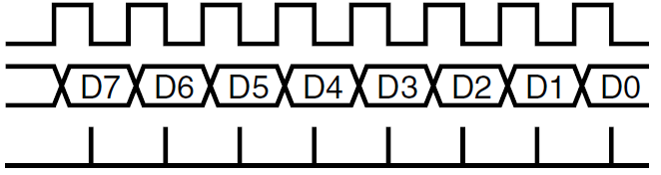
Synchronous Serial Data Transmission
Transmitting Device
Receiving Device
Clock
Serial Data
Data Sampling Time at Receiver
Use shift registers and a clock signal to convert between serial and parallel formats
Synchronous: an explicit clock signal is along with the data signal

Slide 7
Synchronous Full-Duplex Serial Data Bus
Now can use two serial data lines - one for reading, one for writing.
Allows simultaneous send and receive full-duplex communication
Need 4 + 3 = 7 pins on MCU to communicate

Slide 8
Synchronous Half-Duplex Serial Data Bus
Share the serial data line
Need 4 + 2 = 6 pins on MCU to communicate
Doesn’t allow simultaneous send and receive - is half-duplex communication

Slide 9
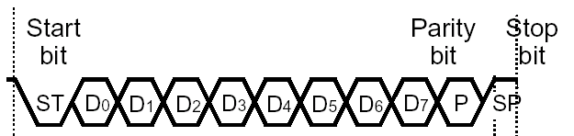
Asynchronous Serial Communication
Data
bits
Data Sampling Time at Receiver
Time Zero
T_{bit}*1.5
T_{bit}*2.5
T_{bit}*3.5
T_{bit}*4.5
T_{bit}*5.5
T_{bit}*6.5
T_{bit}*7.5
T_{bit}*8.5
T_{bit}*9.5
T_{bit}*10.5
Eliminate the clock line!
Transmitter and receiver must generate clock locally
Transmitter must add start bit (always same value) to indicate start of each data frame
Receiver detects leading edge of start bit, then uses it as a timing reference for sampling data line to extract each data bit N at time T_{bit}*(N+1.5)
Stop bit is also used to detect some timing errors

Slide 10
Serial Communication Specifics
Data frame fields
Start bit (one bit)
Data (LSB first or MSB, and size – 7, 8, 9 bits)
Optional parity bit is used to make total number of ones in data even or odd
Stop bit (one or two bits)
All devices must use the same communications parameters
E.g. communication speed (300 baud, 600, 1200, 2400, 9600, 14400, 19200, etc.)
Sophisticated network protocols have more information in each data frame
Medium access control – when multiple nodes are on bus, they must arbitrate for permission to transmit
Addressing information – for which node is this message intended?
Larger data payload
Stronger error detection or error correction information
Request for immediate response (“in-frame”)
Data
bits
Message

Slide 11
Error Detection
Can send additional information to verify data was received correctly
Need to specify which parity to expect: even, odd or none.
Parity bit is set so that total number of “1” bits in data and parity is even (for even parity) or odd (for odd parity)
01110111 has 6 “1” bits, so parity bit will be 1 for odd parity, 0 for even parity
01100111 has 5 “1” bits, so parity bit will be 0 for odd parity, 1 for even parity
Single parity bit detects if 1, 3, 5, 7 or 9 bits are corrupted, but doesn’t detect an even number of corrupted bits
Stronger error detection codes (e.g. Cyclic Redundancy Check) exist and use multiple bits (e.g. 8, 16), and can detect many more corruptions.
Used for CAN, USB, Ethernet, Bluetooth, etc.

Slide 12
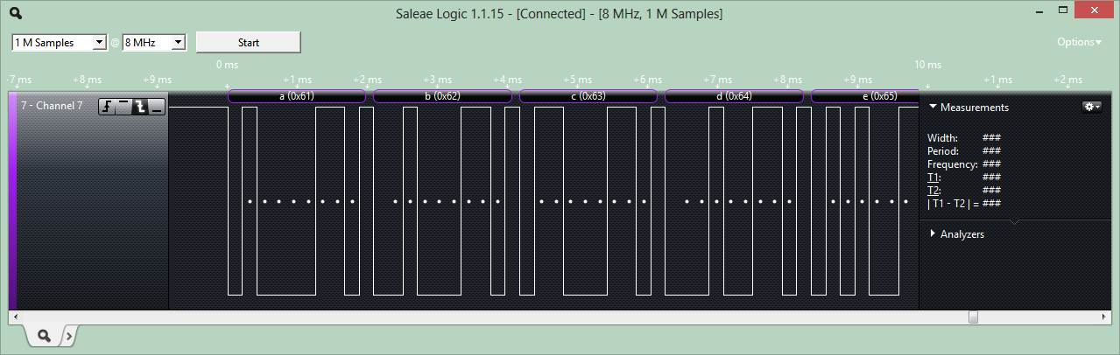
Tools for Serial Communications Development
Tedious and slow to debug serial protocols with just an oscilloscope
Instead use a logic analyzer to decode bus traffic
Worth its weight in gold!
Saelae 8-Channel Logic Analyzer
$150 (www.saelae.com)
Plugs into PC’s USB port
Decodes SPI, asynchronous serial, I²C, 1-Wire, CAN, etc.
Build your own: with Logic Sniffer or related open-source project

Slide 13
Software Architecture for Handling asynchronous Communication

Slide 14
Software Structure
Communication is asynchronous to program
Don’t know what code the program will be executing …
when the next item arrives
when current outgoing item completes transmission
when an error occurs
Need to synchronize between program and serial communication interface somehow
Options
Polling
Wait until data is available
Simple but inefficient of processor time
Interrupt
CPU interrupts program when data is available
Efficient, but more complex

Slide 15
Serial Communications and Interrupts
Want to provide multiple threads of control in the program
Main program (and subroutines it calls)
ISR(s)
Transmit ISR activity – executes when serial interface is ready to send another character
Receive ISR activity – executes when serial interface receives a character
Error ISR(s) activity – execute if an error occurs
Need a way of buffering information between threads
Solution: circular queue with head and tail pointers
One for tx, one for rx
Main Program or other threads
get_string
send_string
ISR:Rx
ISR:Tx
Serial Interface

Slide 16
Enabling and Connecting Interrupts to ISRs
void UART2_IRQHandler() {
if (transmitter ready) {
if (more data to send) {
get next byte
send it out transmitter
}
}
if (received data) {
get byte from receiver
save it
}
if (error occurred) {
handle error
}
}
ARM Cortex-M0+ provides one IRQ for all of a communication interface’s events
Within ISR (IRQ Handler), need to determine what triggered the interrupt, and then service it

Slide 17
Code to Implement Queues
older data
newer data
Enqueue at tail: tail_ptr points to next free entry
Dequeue from head: head_ptr points to item to remove
#define the queue size to make it easy to change
One queue per direction
ISR unloads tx_q for transmit
ISR loads rx_q for receive
Other threads (e.g. main) load tx_q and unload rx_q
Need to wrap pointer at end of buffer to make it circular,
Use % (modulus, remainder) operator if queue size is not power of two
Use & (bitwise and) if queue size is a power of two
Queue is empty if size == 0
Queue is full if size == Q_SIZE
read data from head
write data to tail
get_string
send_string
ISR:Rx
ISR:Tx
Serial
Interface

Slide 18
Defining the Queues
#define Q_SIZE (32)
typedef struct {
unsigned char Data[Q_SIZE];
unsigned int Head; // points to oldest data element
unsigned int Tail; // points to next free space
unsigned int Size; // quantity of elements in queue
} Q_T;
Q_T tx_q, rx_q;
Notes:
Here is the code to define the size of the queue (Q_SIZE), the data type for the queue (Q_T) and to declare two queues (tx_q and rx_q).

Slide 19
Initialization and Status Inquiries
void Q_Init(Q_T * q) {
unsigned int i;
for (i=0; i<Q_SIZE; i++)
q->Data[i] = 0; // to simplify our lives when debugging
q->Head = 0;
q->Tail = 0;
q->Size = 0;
}
int Q_Empty(Q_T * q) {
return q->Size == 0;
}
int Q_Full(Q_T * q) {
return q->Size == Q_SIZE;
}
Notes:
Here is the code for initialization and tests for empty and full.

Slide 20
Enqueue and Dequeue
int Q_Enqueue(Q_T * q, unsigned char d) {
// What if queue is full?
if (!Q_Full(q)) {
q->Data[q->Tail++] = d;
q->Tail %= Q_SIZE;
q->Size++;
return 1; // success
} else
return 0; // failure
}
unsigned char Q_Dequeue(Q_T * q) {
// Must check to see if queue is empty before dequeueing
unsigned char t=0;
if (!Q_Empty(q)) {
t = q->Data[q->Head];
q->Data[q->Head++] = 0; // to simplify debugging
q->Head %= Q_SIZE;
q->Size--;
}
return t;
}
Notes:
Here is the code to enqueue or dequeue an item.

Slide 21
Using the Queues
Sending data:
if (!Queue_Full(…)) {
Queue_Enqueue(…, c)
}
Receiving data:
if (!Queue_Empty(…)) {
c=Queue_Dequeue(…)
}
Notes:
When trying to add or remove data from a queue, we need to check to see if there is space or data available.

Slide 22
Software Designs – Parsing Messages

Slide 23
Decoding Messages
Two types of messages
Actual binary data sent
Detect start of message
Identify message type
Optional: Confirm integrity with CRC
Based on this message type, copy binary data from message fields into variables
May need to use pointers and casting to get code to translate formats correctly and safely
ASCII text characters representing data sent
Detect start of message
Identify message type
Optional: Confirm integrity with CRC
Based on this message type, translate (parse) the data from the ASCII message format into a binary format
Copy the binary data into variables

Slide 24
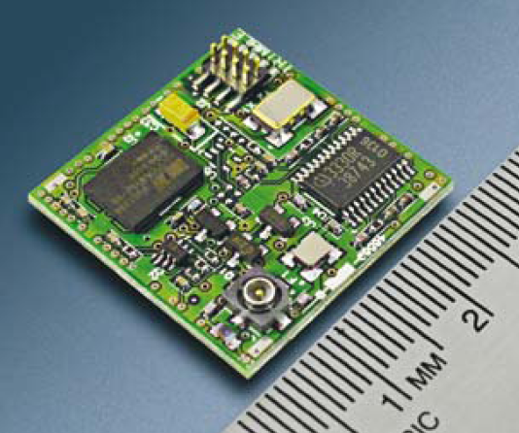
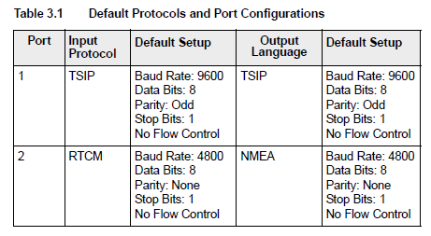
Example UART Application
Many subsystems connect with the rest of the system using asynchronous serial communications
Lassen iQ GPS receiver module from Trimble
Two full-duplex asynch. serial connections
Three protocols supported
Support higher speeds through reconfiguration

Slide 25
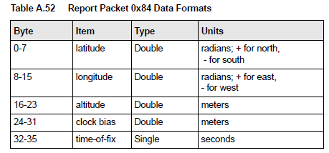
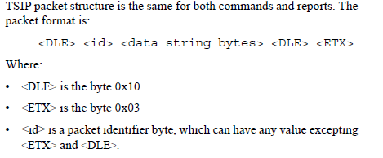
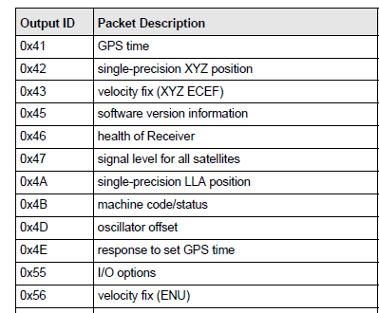
Example Binary Serial Data: TSIP
switch (id) {
case 0x84:
lat = *((double *) (&msg[0]));
lon = *((double *) (&msg[8]));
alt = *((double *) (&msg[16]));
clb = *((double *) (&msg[24]));
tof = *((float *) (&msg[32]));
break;
case 0x4A: …
default:
break;
}
Notes:
Here is an example of a binary data format used by Trimble GPS modules. Each packet begins with a <DLE> code (0x10) and then the id of the packet type. This makes code very easy to write. For example, the C Code presented decodes a packet of type 0x84 and places its fields into several floating point variables without needing any translation or additional processing.

Slide 26
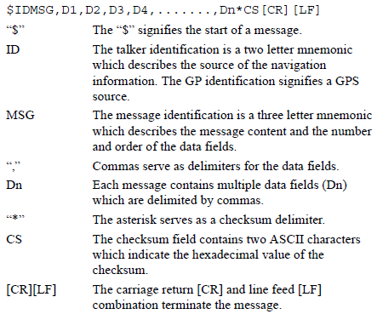
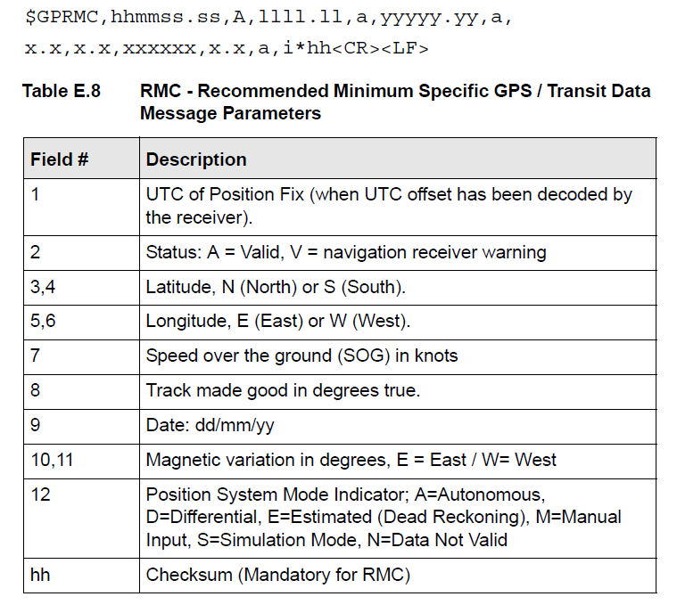
Example ASCII Serial Data: NMEA-0183
Notes:
ASCII serial data is sent in a human readable form. However, this means the code to process it must convert it back to a native binary format before using it. We will see how on the next pages.

Slide 27
State Machine for Parsing NMEA-0183
Start
Any char. except *, \r or \n
Append char to buf. Inc. counter
$ Append char to buf.
Talker + Sentence Type
*, \r or \n, non-text, or counter>6
buf==$SDDBT, $VWVHW, or $YXXDR
Enqueue all chars. from buf
/r or /n
Sentence Body
Any char. except *
Enqueue char
*
Enqueue char
Checksum 1
Any char.
Save as checksum1
Checksum 2
Any char.
Save as checksum2
Notes:
We start by designing the code to decode the sentence. We wait for a $ which indicates the start of the sentence. Then we start accepting characters and transition between states based on the delimiters. After getting these fields we can work on decoding the received text (e.g. “43.781”) into actual values (e.g. a floating point variable).

Slide 28
Parsing
switch (parser_state) {
case TALKER_SENTENCE_TYPE:
switch (msg[i]) {
‘*’:
‘\r’:
‘\n’:
parser_state = START;
break;
default:
if (Is_Not_Character(msg[i]) || n>6) {
parser_state = START;
} else {
buf[n++] = msg[i];
}
break;
}
if ((n==6) & … ){
parser_state = SENTENCE_BODY;
}
break;
case SENTENCE_BODY:
break;

Slide 29
KL25Z and Freedom Specifics

Slide 30
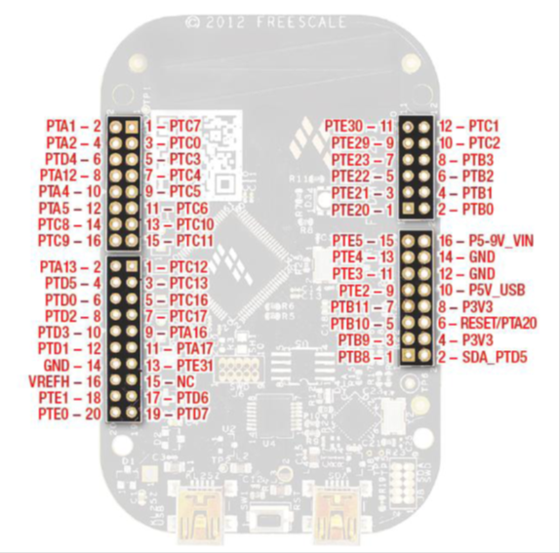
Freedom KL25Z Serial I/O
UART
SPI
I²C
Notes:
The Freedom KL25Z supports three types of serial I/O across a range of pins.

Slide 31
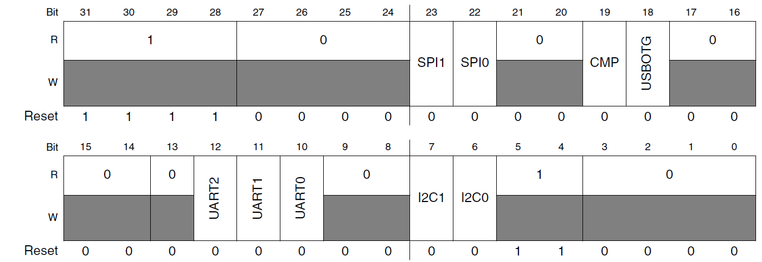
KL25Z Clock Gating for Serial Comm.
Set corresponding bit(s) in SIM_SCGC4 Register
Notes:
Before configuring a serial peripheral, be sure to enable its clock.

Slide 32
SPI Communications

Slide 33
Hardware Architecture
All chips share bus signals
Clock SCK
Data lines MOSI (master out, slave in) and MISO (master in, slave out)
Each peripheral has its own chip select line (CS)
Master (MCU) asserts the CS line of only the peripheral it’s communicating with

Slide 34
Serial Data Transmission
Transmitting Device
Receiving Device
Clock
Serial Data
Data Sampling Time at Receiver
Use shift registers and a clock signal to convert between serial and parallel formats
Synchronous: an explicit clock signal is along with the data signal

Slide 35
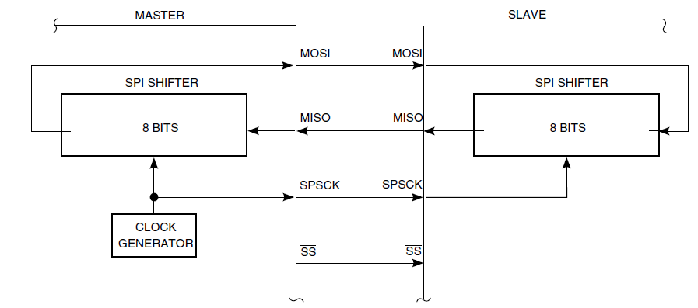
SPI Signal Connection Overview
SPI Communication consists of a series of data swaps between the Master and the Slave
As the master shifts out its transmit byte, it is also shifting in the received byte from the Slave
Notes:
Here we can see that the SPI communication uses two shift registers (one in the master and one in the slave) which are connected in a ring. The master exchanges the data in these two registers by sending a series of clock pulses on the SPSCK signal.

Slide 36
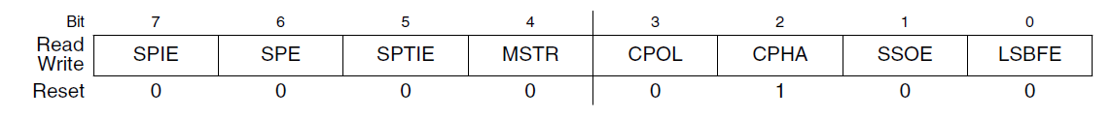
SPI Control Register 1 (SPIx_C1)
SPIE: SPI interrupt enable for receive buffer full and mode fault
SPE: SPI system enable
SPTIE: SPI interrupt enable for transmit buffer empty
MSTR: select master mode
CPOL: Clock polarity
CPHA: Clock phase
SSOE: Slave select output enable

Slide 37
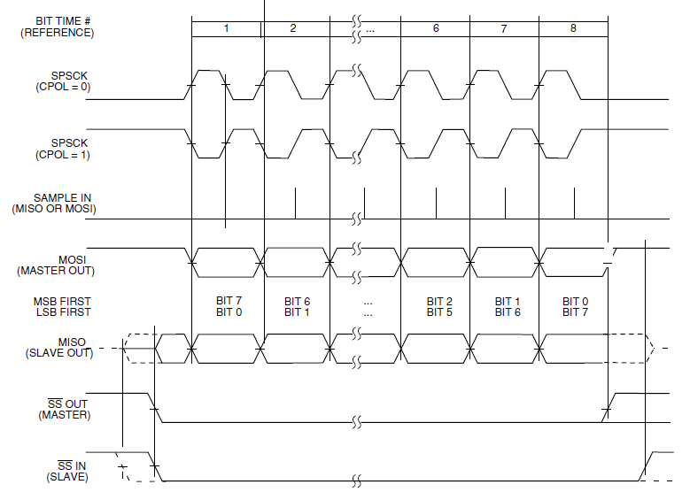
Clock and Phase Settings: CPHA = 1
Notes:
Here is an example of how data communication occurs in with CPHA=1. In this case, the first clock signal edge shifts out the data, and the second clock signal edge indicates it is valid. The Slave Select (SS) line does not enable the transmission of any data until the clock is asserted.

Slide 38
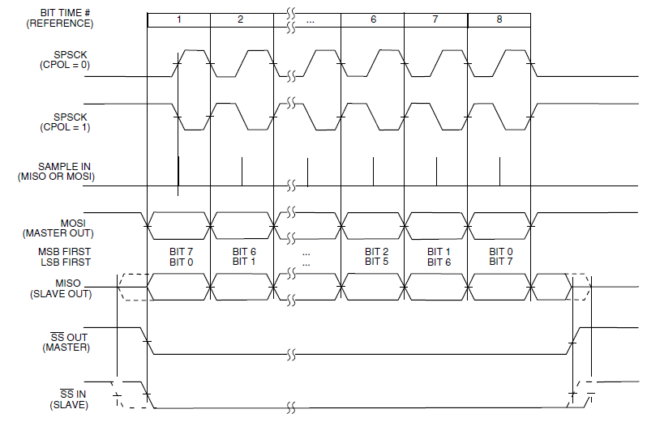
Clock and Phase Settings: CPHA = 0
Notes:
Here CPHA is 0. The master and slave enable their data outputs with valid data as soon as the slave select (SS) line is asserted. The first clock edge indicates the data is valid, and the second clock edge shifts out the next bit.

Slide 39
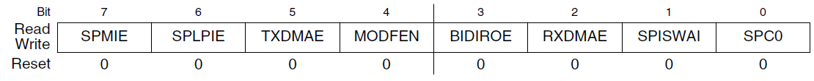
SPI Control Register 2 (SPIx_C2)
SPMIE: SPI interrupt enable for receive data match
SPLPIE: SPI interrupt enable for wake from low-power mode
TXDMAE: Transmit DMA enable
MODFEN: Master mode-fault function enable
BIDIROE
RDDMAE: Receive DMA enable
SPISWAI: Stop SPI in wait mode
SPC0: Single wire (bidirectional) mode

Slide 40
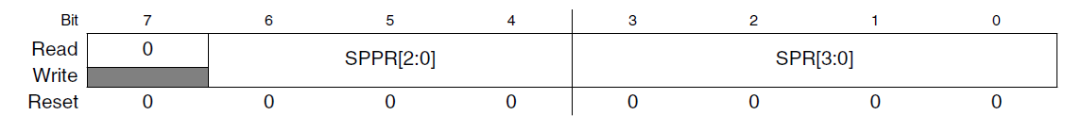
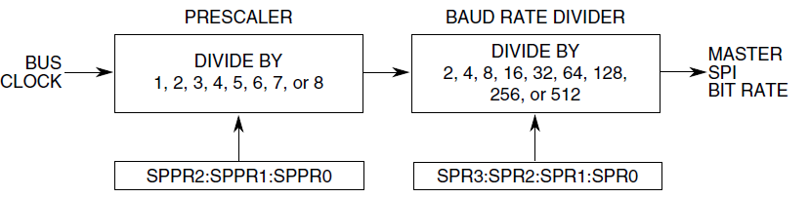
SPI Baud Rate Register (SPIx_BR)
SPPR: SPI baud rate prescale divisor: divides by n+1
SPR: SPI baud rate divisor: divides by 2^{n+1}
f_{SPI} = f_{bus_clock}/((SPPR+1)*2^{SPR+1})
Notes:
This register controls how quickly the SPI bus communicates. Typically SPI peripherals can communicate at very high speeds (e.g. 1 MHz, 10 MHz or more).

Slide 41
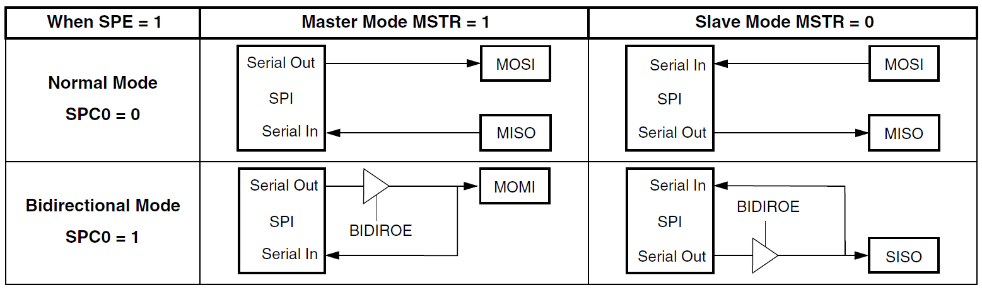
Normal and Bidirectional Modes
Notes:
The SPI peripheral can operate in bidirectional mode, in which it reduces pin count by sharing the same signal (MOMI or SISO) to send and receive data. This only allows half-duplex communication.

Slide 42
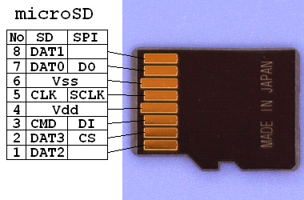
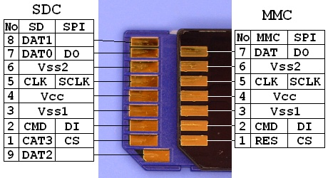
SPI Example: Secure Digital Card Access
SD cards have two communication modes
Native 4-bit
Legacy SPI 1-bit
SPI mode 0
CPHA=0
CPOL=0
V_{DD} from 2.7 to 3.6 V
CS: Chip Select (active low)
Source – FatFS FAT File System Module:
http://elm-chan.org/docs/mmc/mmc_e.html
http://elm-chan.org/fsw/ff/00index_e.html

Slide 43
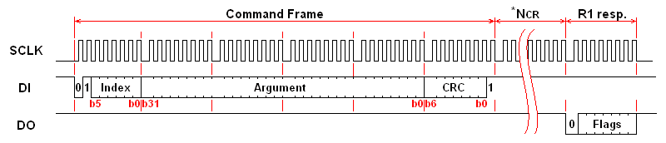
SPI Commands for SD Card
Host sends a six-byte command packet to card
Index, argument, CRC
Host reads bytes from card until card signals it is ready
Card returns
0xff while busy
0x00 when ready without errors
0x01-0x7f when error has occurred

Slide 44
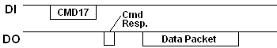
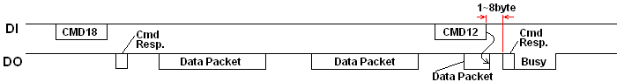
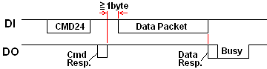
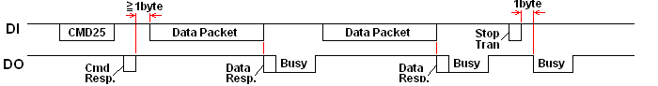
SD Card Transactions
Single Block Read
Multiple Block Read
Single Block Write
Multipe Block Write
Notes:
Here we see several examples of SPI communications with an SD Card controller. For example, the MCU sends a command (e.g. CMD17), and then polls the SD Card repeatedly until the command response indicates the data is ready. The SD Card controller then responds with the data.

Slide 45
I²C Communications

Slide 46
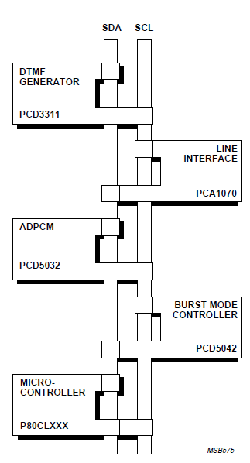
I²C Bus Overview
“Inter-Integrated Circuit” bus
Multiple devices connected by a shared serial bus
Bus is typically controlled by master device, slaves respond when addressed
I²C bus has two signal lines
SCL: Serial clock
SDA: Serial data
Full details available in “The I²C-bus Specification”
Notes:
Note that with I2C there is no chip select line needed to address a particular slave. Instead, each I2C transaction contains an address. Only the addressed slave responds.

Slide 47
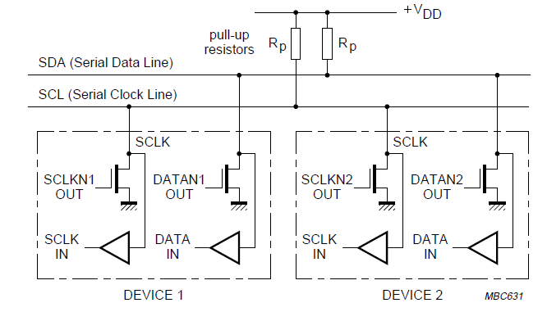
I²C Bus Connections
Resistors pull up lines to V_{DD}
Open-drain transistors pull lines down to ground
Master generates SCL clock signal
Can range up to 400 kHz, 1 MHz, or more

Slide 48
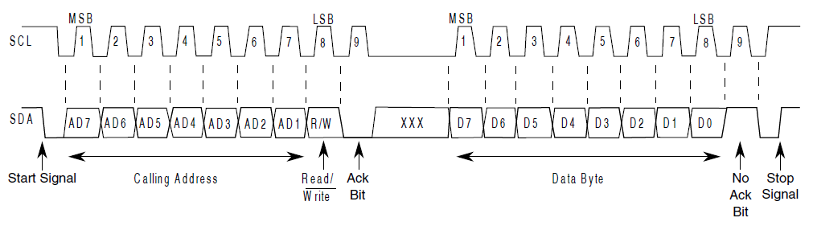
I²C Message Format
Message-oriented data transfer with four parts
Start condition
Slave Address transmission
Address
Command (read or write)
Acknowledgement by receiver
Data fields
Data byte
Acknowledgement by receiver
Stop condition
Message is made of
Signals: Start, Stop, Repeated Start
Bytes
Acknowledgement bits

Slide 49
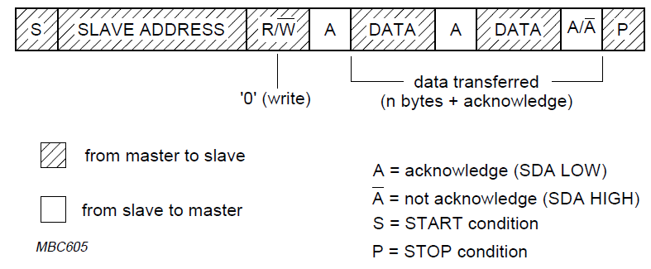
Master Writing Data to Slave
Notes:
Here we see the series of bytes sent when a master writes data to a slave.

Slide 50
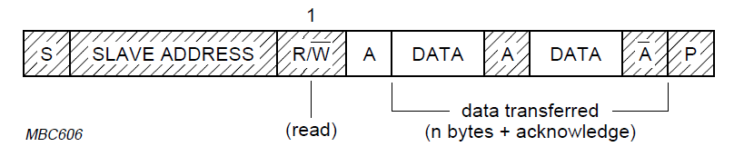
Master Reading Data from Slave
Notes:
Reading data is similar, but the slave transmits the data bytes, while the master acknowledges them.

Slide 51
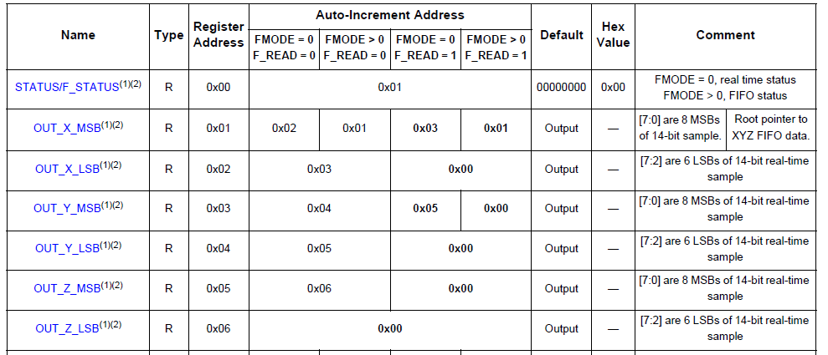
I²C Addressing: Devices and Registers
Slave device addressing
Each slave device has a seven-bit address
Can support up to 2⁷=128 different devices on same bus
Different types of device have different default addresses
Sometimes can select a secondary default address by tying a device pin to a different logic level
Register addressing
I2C devices may have multiple control, status, data registers and even data memory internally – how do we get at it?
Use the first byte of data as a register address
Example: First seven registers of MMA8451 I2C accelerometer
0x32
0x16
0x66
0x20
Master

Slide 52
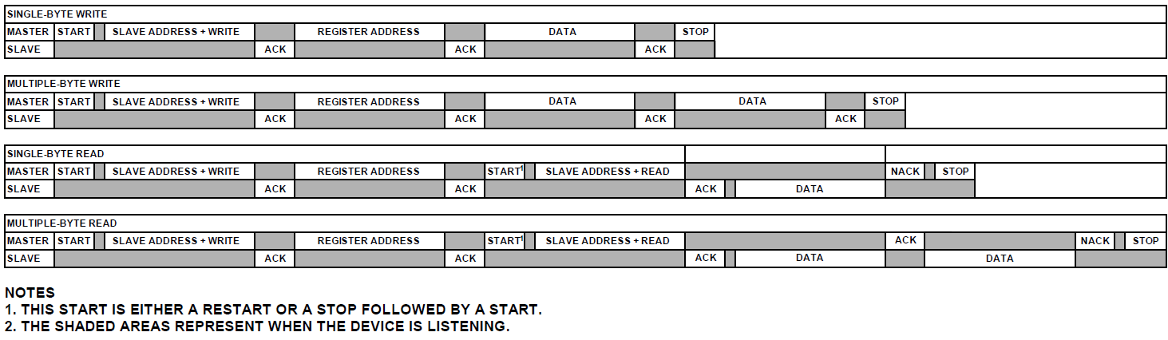
I²C with Register Addressing
Master drives communication
Sends start condition, address of slave, read/write command
Listens for acknowledgement from slave
Sends register address (byte)
Listens for acknowledgement from slave

Slide 53
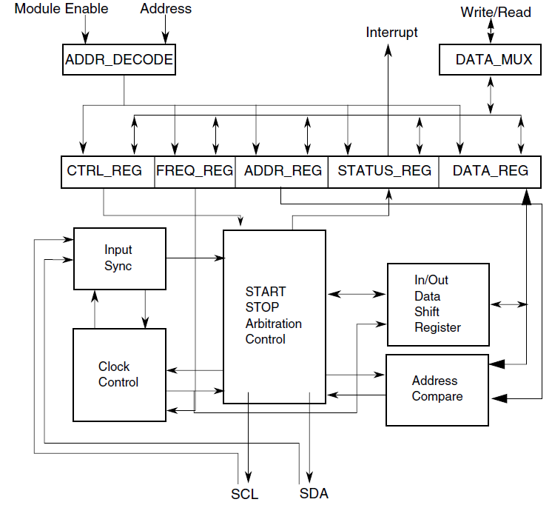
KL25Z I2C Controller
Notes:
Here is an overview of the I2C controller in the MCU. The core parts are the in/out data shift register and clock control, but other logic has been added for I2C features.

Slide 54

Setting the I²C Baud Rate
I2Cx_F: Frequency Divider register
MULT: specified multiplier mul = 2^{MULT}
valid values: 1, 2,4
ICR: Clock Rate
I2C baud rate = f_{bus}/ (2^{MULT} * ICR)
Notes:
I2C baud rates are generally much slower than SPI, running at 100 kHz, 400 kHz, or maybe 1 MHz.

Slide 55

I2C Control Register 1 – I2Cx_C1
IICEN - enable I2C module
IICIE - enable I2C interrupt
MST - select master mode
0➔1 generates Start condition
1➔0 generates Stop condition
TX – Select 1 for master transmit and 0 for master receive
TXAK – Transmit Acknowledge enable
RSTA – Repeat Start
WUEN – Wakeup enable
DMAEN – Enable DMA

Slide 56
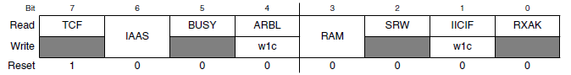
I2C Status Register – I2Cx_S
TCF – Transfer Complete flag set after transferring byte and acknowledge bit
IAAS – Addressed as a Slave
BUSY – bus busy
ARBL – arbitration lost
RAM – Range address match
SRW – when slave, indicates transmission direction (0: slave receive, 1: slave transmit)
IICIF: Interrupt pending flag
RXAK: 0: acknowledge signal received

Slide 57
I2C Data Register – I2Cx_D
8-bit data register
Master transmit mode
Writing to I2Cx_D starts a data transfer
Master receive mode
Reading from I2Cx_D starts reception of next byte

Slide 58
Macros for Polled Communications
#define I2C_M_START I2C0->C1 |= I2C_C1_MST_MASK
#define I2C_M_STOP I2C0->C1 &= ~I2C_C1_MST_MASK
#define I2C_M_RSTART I2C0->C1 |= I2C_C1_RSTA_MASK
#define I2C_TRAN I2C0->C1 |= I2C_C1_TX_MASK
#define I2C_REC I2C0->C1 &= ~I2C_C1_TX_MASK
#define BUSY_ACK while(I2C0->S & 0x01)
#define TRANS_COMP while(!(I2C0->S & 0x80))
#define I2C_WAIT while((I2C0->S & I2C_S_IICIF_MASK)==0){} \
I2C0->S |= I2C_S_IICIF_MASK;
#define NACK I2C0->C1 |= I2C_C1_TXAK_MASK
#define ACK I2C0->C1 &= ~I2C_C1_TXAK_MASK
Notes:
The file i2c.h has useful macros for busy-wait I2C communications.

Slide 59
Writing a Single Byte to a Device
I2C_TRAN; /*set to transmit mode */
I2C_M_START; /*send start */
I2C0->D = dev; /*send dev address */
I2C_WAIT; /*wait for ack */
I2C0->D = address; /*send write address */
I2C_WAIT;
I2C0->D = data; /*send data */
I2C_WAIT;
I2C_M_STOP;

Slide 60
Reading a Single Byte from a Device
I2C_TRAN; /*set to transmit mode */
I2C_M_START; /*send start */
I2C0->D = dev; /*send dev address */
I2C_WAIT; /*wait for completion */
I2C0->D = address; /*send read address */
I2C_WAIT; /*wait for completion */
I2C_M_RSTART; /*repeated start */
I2C0->D = (dev|0x1); /*send dev address (read) */
I2C_WAIT; /*wait for completion */
I2C_REC; /*set to recieve mode */
NACK; /*set NACK after read */
data = I2C0->D; /*dummy read */
I2C_WAIT; /*wait for completion */
I2C_M_STOP; /*send stop */
data = I2C0->D; /*read data */

Slide 61
Reading Multiple Bytes from a Device: Set Up
I2C_TRAN; /*set to transmit mode */
I2C_M_START; /*send start */
I2C0->D = dev; /*send dev address */
I2C_WAIT; /*wait for ack */
I2C0->D = address; /*send read address */
I2C_WAIT; /*wait for completion */
I2C_M_RSTART; /*repeated start */
I2C0->D = (dev|0x1); /*send dev address (read) */
I2C_WAIT; /*wait for completion */
I2C_REC; /*set to receive mode */

Slide 62
Reading Multiple Bytes from a Device: Data
// For each byte
if(isLastRead) {
NACK; /*set NACK after read */
} else {
ACK; /*ACK after read */
}
data = I2C0->D; /*dummy read */
I2C_WAIT; /*wait for completion */
if(isLastRead) {
I2C_M_STOP; /*send stop */
}
data = I2C0->D; /*read real data */
Notes:
Reading multiple bytes accelerates communication by reducing the overhead of setting up multiple transactions.

Slide 63
Interrupt-Driven I2C Communications
Example flowchart from KL25Z Reference Manual chapter on I2C peripheral
One ISR handles all possible cases
Is MCU is in master or slave mode?
Arbitration lost (in multi-master bus)?
Transmit or receive?
More data to send?
Acknowledge received?
etc.

Slide 64
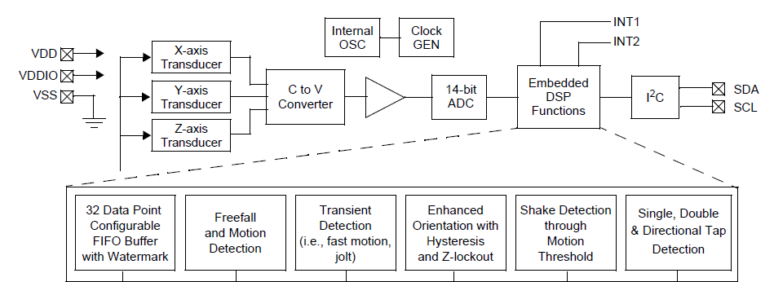
Example I²C Peripheral: 3-Axis Accelerometer
Freescale MMA8451, included in Freedom KL25Z board
Freedom KL26Z board has 3-axis accelerometer and 3-axis magnetometer (compass)
Can measure acceleration in x/y/z directions up to ±2g, ± 4g, ± 8g
Can compute rotation about x/y axes (pitch, roll)
I2C addresses are 0x3A (read) and 0x3B (write)
011101r (r=1 for read, r=0 for write)

Slide 65
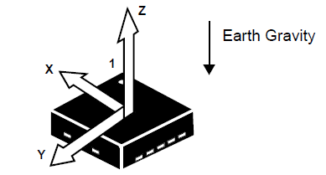
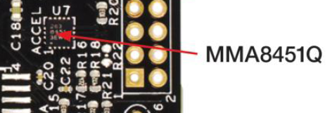
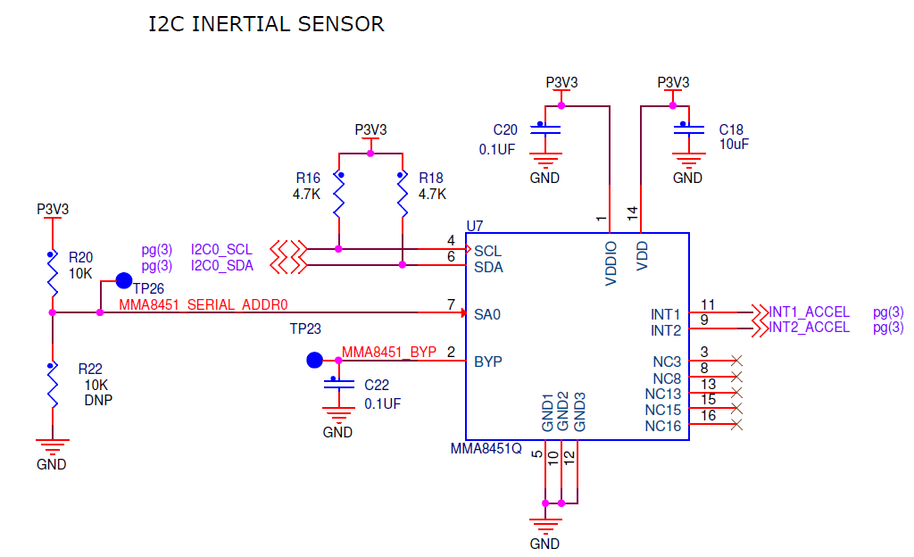
MMA8451 on Freedom KL25Z
Notes:
Here we see where the accelerometer is located on the Freedom board, the circuit, and the x/y/z axis orientations.

Slide 66
Main Registers of Interest in MMA8451
Acceleration Data
Signed (two’s complement) data
14 or 8 bits per channel (left aligned)
X-axis: 0x01, 0x02
Y-axis: 0x03, 0x04
Z-axis: 0x05, 0x06
Resolution is about 1/4096 g per LSB (in +/- 2 g mode)
Who Am I?
Used to identify which device this is (IC-specific)
Device ID - 0x1A

Slide 67
Control Register 1 (0x2A)
ACTIVE: set to 1 to put in active (not standby) mode
FREAD: set to 1 to fast read just 8 MSBs of XYZ data
LNOISE: low noise mode
DR2-0: select output data rate from 1.56 Hz to 800 Hz
ASLP_RATE1-0: Select Sleep mode rate from 1.56 to 50 Hz
DR2 | DR1 | DR0 | Output Data Rate
0 | 0 | 0 | 800 Hz
0 | 0 | 1 | 400
0 | 1 | 0 | 200
0 | 1 | 1 | 100
1 | 0 | 0 | 50
1 | 0 | 1 | 12.5
1 | 1 | 0 | 6.25
1 | 1 | 1 | 1.56

Slide 68
Registers for Additional Features
FIFO configuration
Interrupt control and status
Dynamic range
High-pass filter configuration
Portrait/Landscape detection settings
Freefall detection settings
Sleep control registers
Offset per axis
Transient event detection settings
Tap (pulse) detection settings
Notes:
The device supports many additional features which can be configured with their own control registers.

Slide 69
Demonstration: Configure the Accelerometer
if(i2c_read_byte(MMA_ADDR, REG_WHOAMI) == WHOAMI) {
Delay(10);
//set active, 14 bit data and 100 Hz ODR (0x19)
i2c_write_byte(MMA_ADDR, REG_CTRL1, 0x01);
return 1;
}
Source code in mma8451.c
Basic approach
Read byte from the WHOAMI register, verify it matches expected value for MMA8451
Delay…
Set to active, 14-bit mode, 100 Hz sampling rate

Slide 70
Demonstration: Read the Accelerations
Send I2C Start condition
Send read addresses (device and register)
Read first five bytes of data into data[i]
Read last byte of data into data[i] (also sends stop condition)
Append bytes to form 16-bit words (int16_t)
Divide by four to adjust for scaling
i2c_start();
i2c_read_setup(MMA_ADDR , REG_XHI);
for( i=0;i<5;i++) {
data[i] =
i2c_repeated_read(1);
}
data[i] = i2c_repeated_read(0);
for ( i=0; i<3; i++ ) {
temp[i] = (int16_t)
((data[2*i]<<8) |
data[2*i+1]);
}
// Right-justify, is 14 bits
acc_X = temp[0]/4;
acc_Y = temp[1]/4;
acc_Z = temp[2]/4;

Slide 71
Asynchronous serial (UART) Communications

Slide 72
Transmitter Basics
Data
bits
Data Sampling Time at Receiver
T_{bit}
T_{bit}
T_{bit}
T_{bit}
T_{bit}
T_{bit}
T_{bit}
T_{bit}
T_{bit}
T_{bit}
T_{bit}
Time Zero
If no data to send, keep sending 1 (stop bit) – idle line
When there is a data word to send
Send a 0 (start bit) to indicate the start of a word
Send each data bit in the word (use a shift register for the transmit buffer)
Send a 1 (stop bit) to indicate the end of the word

Slide 73
Receiver Basics
Data
bits
Data Sampling Time at Receiver
Time Zero
T_{bit}*1.5
T_{bit}*2.5
T_{bit}*3.5
T_{bit}*4.5
T_{bit}*5.5
T_{bit}*6.5
T_{bit}*7.5
T_{bit}*8.5
T_{bit}*9.5
T_{bit}*10.5
Wait for a falling edge (beginning of a Start bit)
Then wait ½ bit time
Do the following for as many data bits in the word
Wait 1 bit time
Read the data bit and shift it into a receive buffer (shift register)
Wait 1 bit time
Read the bit
if 1 (Stop bit), then OK
if 0, there’s a problem!

Slide 74
For this to work…
Transmitter and receiver must agree on several things (protocol)
Order of data bits
Number of data bits
What a start bit is (1 or 0)
What a stop bit is (1 or 0)
How long a bit lasts
Transmitter and receiver clocks must be reasonably close in frequency, since the only timing reference is the start of the start bit

Slide 75
KL25 UARTs
UART: Universal (configurable) Asynchronous Receiver/Transmitter
UART0
Low Power
Can oversample from 4x to 32x
Is used by debugger MCU on Freedom KL25Z, so not available
UART1, UART2
More basic, fewer features, easier to program

Slide 76
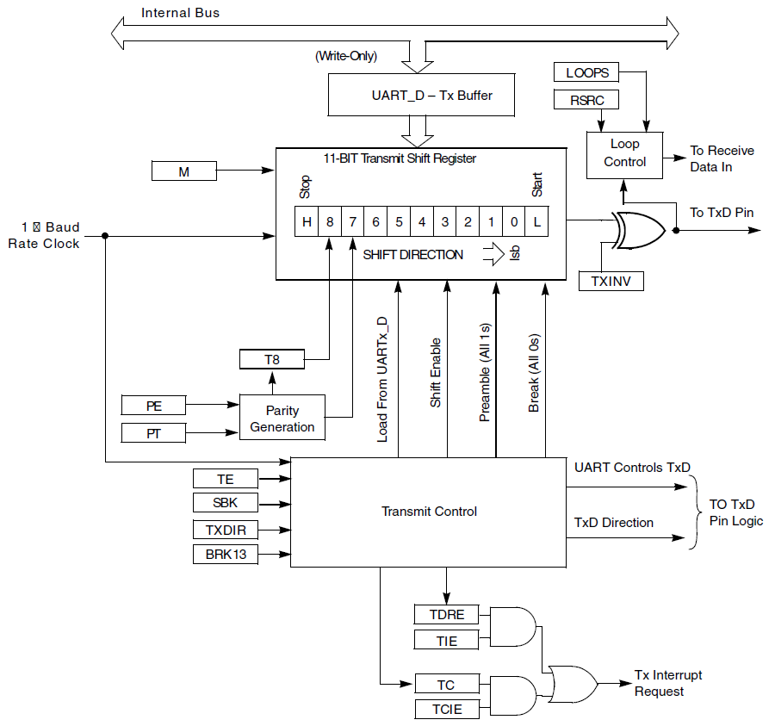
UART Transmitter
Notes:
The heart of the transmitter is a parallel-to-serial shift register which holds the data to send, parity, a start bit (Low, 0) and a stop bit (High, 1). This information is shifted out to the TxD pin.

Slide 77
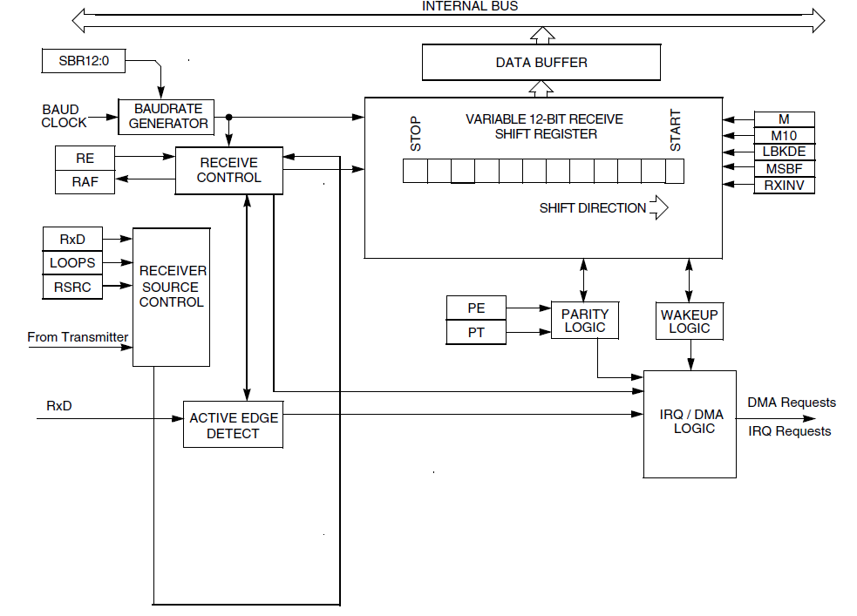
UART Receiver
Notes:
The receiver contains a serial-to-parallel shift register which accepts incoming data and verifies it is formatted correctly.

Slide 78
Input Data Oversampling
When receiving, UART oversamples incoming data line
Extra samples allow voting, improving noise immunity
Better synchronization to incoming data, improving noise immunity
UART0 provides configurable oversampling from 4x to 32x
Put desired oversampling factor minus one into UART0 Control Register 4, OSR bits.
UART1, UART2 have fixed 16x oversampling

Slide 79
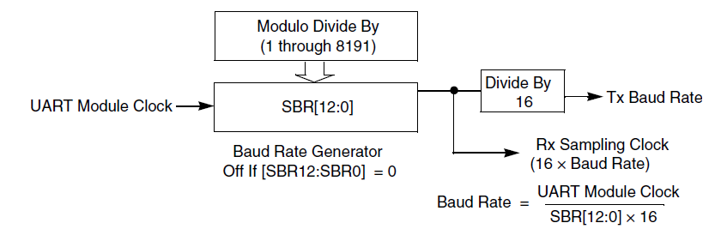
Baud Rate Generator
Need to divide module clock frequency down to desired baud rate * oversampling factor
Example
24 MHz -> 4800 baud with 16x oversampling
Division factor = 24E6/(4800*16) = 312.5. Must round to closest integer value ( 312 or 313), will have a slight frequency error.

Slide 80
Using the UART
When can we transmit?
Transmit buffer must be empty
Can poll UARTx->S1 TDRE flag
Or we can use an interrupt, in which case we will need to queue up data
Put data to be sent into UARTx_D (UARTx->D in with CMSIS)
When can we receive a byte?
Receive buffer must be full
Can poll UARTx->S1 RDRF flag
Or we can use an interrupt, and again we will need to queue the data
Get data from UARTx_D (UARTx->D in with CMSIS)

Slide 81

UART Control Register 1 (UART0_C1)
LOOPS: Enables loopback/single-pin (TX/RX) mode
DOZEEN: Doze enable – disable UART in sleep mode
RSRC: Selects between loopback and single-pin mode
M: Select 9-bit data mode (instead of 8-bit data)
WAKE: Wakeup method
ILT: Idle line type
PE: Parity enabled with 1
PT: Odd parity with 1, even parity with 0

Slide 82

UART Control Register 2 (UART0_C2)
Interrupt Enables
TIE: Interrupt when Transmit Data Register is empty
TCIE: Interrupt when transmission completes
RIE: Interrupt when receiver has data ready
Module Enables
TE: Transmitter enable
RE: Receiver enable
Other
RWU: Put receiver in standby mode, will wake up when condition occurs
SBK: Send a break character (all zeroes)

Slide 83

UART Status Register 1 (UART_S1)
TDRE: Transmit data register empty, can write more data to data register
TC: Transmission complete.
RDRF: Receiver data register full, can read data from data register
IDLE: UART receive line has been idle for one full character time
OR: Receive overrun. Received data has overwritten previous data in receive buffer
NF: Noise flag. Receiver data bit samples don’t agree.
FE: Framing error. Received 0 for a stop bit, expected 1.
PF: Parity error. Incorrect parity received.

Slide 84

UART Status Register 2 (UARTx_S2)
LBDIF: LIN break detect interrupt flag
RXEDGIF: Active edge on receive pin detected
MSBF: Send MSB first. Should be 0 for RS232
RXINV: Invert received signals (data, start, stop, etc.)
RWUID: Set idle bit upon wakeup?
BRK13: Set break character to 13 bits long (not 10)
LBKDE: LIN break character time.
RAF: Receiver is actively receiving data (not idle line)

Slide 85
Software for Polled Serial Comm.
void Init_UART2(uint32_t baud_rate) {
uint32_t divisor;
// enable clock to UART and Port A
SIM->SCGC4 |= SIM_SCGC4_UART2_MASK;
SIM->SCGC5 |= SIM_SCGC5_PORTE_MASK;
// connect UART to pins for PTE22, PTE23
PORTE->PCR[22] = PORT_PCR_MUX(4);
PORTE->PCR[23] = PORT_PCR_MUX(4);
// ensure tx and rx are disabled before configuration
UART2->C2 &= ~(UARTLP_C2_TE_MASK | UARTLP_C2_RE_MASK);
// Set baud rate to 4800 baud
divisor = BUS_CLOCK/(baud_rate*16);
UART2->BDH = UART_BDH_SBR(divisor>>8);
UART2->BDL = UART_BDL_SBR(divisor);
// No parity, 8 bits, two stop bits, other settings;
UART2->C1 = UART2->S2 = UART2->C3 = 0;
// Enable transmitter and receiver
UART2->C2 = UART_C2_TE_MASK | UART_C2_RE_MASK;
}
Notes:
This code initializes UART2 for polled communication. First the clocks are enabled for UART2 and PORTE (since UART2 uses the PORTE pins). Then the pin configuration registers are set so the muxes connect the UART to the pins for PTE22 and PTE23. Then the UART is configured as described and then enabled.

Slide 86
Polled Serial Transmitter Code
void UART2_Transmit_Poll(uint8_t data) {
// wait until transmit data register is empty
while (!(UART2->S1 & UART_S1_TDRE_MASK))
;
UART2->D = data;
}
void main(void) {
char c;
// Initialization goes here
while (1) {
for (c='a'; c<='z'; c++) {
UART2_Transmit_Poll(c);
}
Notes:
This code sends a byte of data, performing busy waiting as needed. The transmit function does not return until it has been able to send its byte.
The main function sends characters from a to z repeatedly as fast as possible.

Slide 87
Polled Serial Receiver Code with Echo
uint8_t UART2_Receive_Poll(void) {
// wait until receive data register is full
while (!(UART2->S1 & UART_S1_RDRF_MASK))
;
return UART2->D;
}
void main(void) {
char c;
// Initialization goes here
while (1) {
c = UART2_Receive_Poll();
UART2_Transmit_Poll(c);
}
Notes:
The receive function does not return until it has a byte. If no data is ever received, then the receive function will never return and the program will be stuck here.
The main function echoes back every character it receives

Slide 88
Software for Interrupt-Driven Serial Comm.
Use interrupts
First, initialize peripheral to generate interrupts
Second, create single ISR with three sections corresponding to cause of interrupt
Transmitter
Receiver
Error
Notes:
Let’s look at using interrupts instead of polling. This will make the software much more modular and efficient, allowing the MCU to share its time among many tasks easily.

Slide 89
Peripheral Initialization
void Init_UART2(uint32_t baud_rate) {
…
NVIC_SetPriority(UART2_IRQn, 2);
NVIC_ClearPendingIRQ(UART2_IRQn);
NVIC_EnableIRQ(UART2_IRQn);
UART2->C2 |= UART_C2_TIE_MASK |
UART_C2_RIE_MASK;
UART2->C2 |= UART_C2_RIE_MASK;
Q_Init(&TxQ);
Q_Init(&RxQ);
}
Notes:
Here we add code to the Init_UART2 function to configure the NVIC and enable the UART to generate interrupts.

Slide 90
Interrupt Handler: Transmitter
void UART2_IRQHandler(void) {
NVIC_ClearPendingIRQ(UART2_IRQn);
if (UART2->S1 & UART_S1_TDRE_MASK) {
// can send another character
if (!Q_Empty(&TxQ)) {
UART2->D = Q_Dequeue(&TxQ);
} else {
// queue is empty so disable tx
UART2->C2 &= ~UART_C2_TIE_MASK;
}
}
…
Notes:
The UART IRQ Handler needs to check to see if a transmission completion caused the interrupt, in which case it needs either send the next data item or else stop transmitting.

Slide 91
Interrupt Handler: Receiver
void UART2_IRQHandler(void) {
…
if (UART2->S1 & UART_S1_RDRF_MASK) {
// received a character
if (!Q_Full(&RxQ)) {
Q_Enqueue(&RxQ, UART2->D);
} else {
// error - queue full.
while (1)
;
}
}
Notes:
The UART IRQ handler also needs to check to see if a reception completion caused the interrupt, in which case the character should be removed from the UART and enqueued. If the queue is full then we have an error – in this case we freeze the system so the developer is sure to notice the problem.

Slide 92
Interrupt Handler: Error Cases
void UART2_IRQHandler(void) {
…
if (UART2->S1 & (UART_S1_OR_MASK |
UART_S1_NF_MASK |
UART_S1_FE_MASK |
UART_S1_PF_MASK)) {
// handle the error
// clear the flag
}
}
Notes:
The IRQ handler also needs to handle possible communication error cases (parity error, framing error, etc) – these responses will be situation dependent. These generally result from UART misconfiguration, noise on the incoming data, or not reading the data from the UART before the next data item arrives.

Slide 93
Example UART Application
Many subsystems connect with the rest of the system using asynchronous serial communications
Lassen iQ GPS receiver module from Trimble
Two full-duplex asynch. serial connections
Three protocols supported
Support higher speeds through reconfiguration

Slide 94
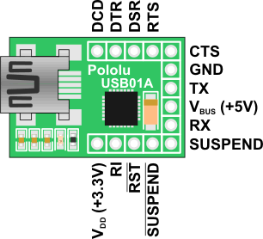
USB to UART Interface
PCs haven’t had external asynchronous serial interfaces for a while, so how do we communicate with a UART?
USB to UART interface
USB connection to PC
Logic level (0-3.3V) to microcontroller’s UART (not RS232 voltage levels)
USB01A USB to serial adaptor
http://www.pololu.com/catalog/product/391
Can also supply 5 V, 3.3 V from USB

Slide 95
Building on Asynchronous Comm.
Asynchronous communication is useful but runs into some problems when applying it to some applications
Problem #1
Logic-level signals (0 to 1.65 V, 1.65 V to 3.3 V) are sensitive to noise and signal degradation
Problem #2
Point-to-point topology does not support a large number of nodes well
Need a dedicated wire to send information from one device to another
Need a UART channel for each device the MCU needs to talk to
Single transmitter, single receiver per data wire

Slide 96
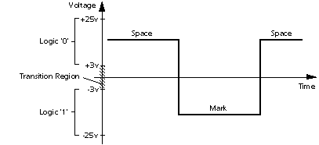
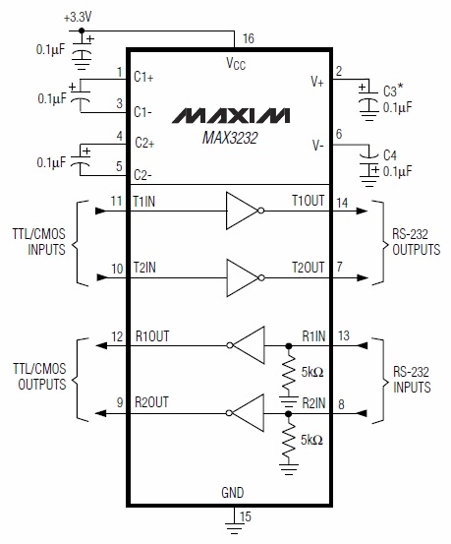
Solution to Noise: Higher Voltages
Use higher voltages to improve noise margin: +3 to +15 V, -3 to -15 V
Example IC (Maxim MAX3232) uses charge pumps to generate higher voltages from 3.3V supply rail

Slide 97
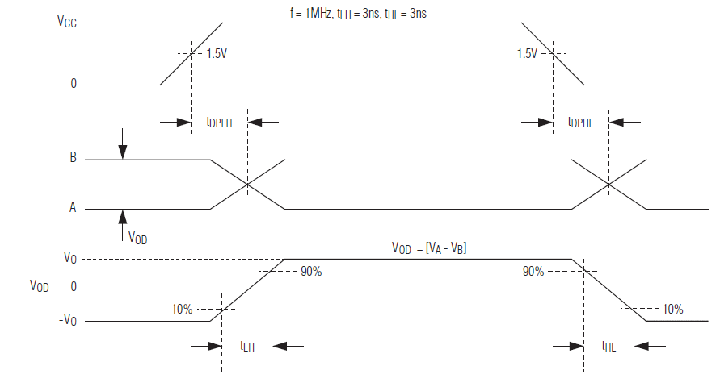
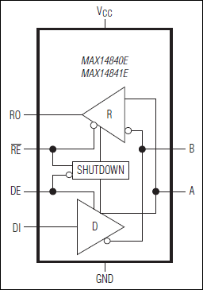
Solution to Noise: Differential Signaling
Data into Transmitter
Data out of Transmitter, on bus
Data out of Receiver
Use differential signaling
Send two signals: Buffered data (A), buffered complement of data (B)
Receiver compares the two signals to determine if data is a one (A > B) or a zero (B > A)

Slide 98
Solutions to Poor Scaling
Approaches
Allow one transmitter to drive multiple receivers (multi-drop)
Connect all transmitters and all receivers to same data line (multi-point network). Need to add a medium access control technique so all nodes can share the wire
Example Protocols
RS-232: higher voltages, point-to-point
RS-422: higher voltages, differential data transmission, multi-drop
RS-485: higher voltages, multi-point

Slide 99
Example Protocols
RS-232: higher voltages, point-to-point
RS-422: higher voltages, differential data transmission, multi-drop
RS-485: higher voltages, multi-point

Slide 100
Protocol Comparison

Slide 101
Factors to Consider
How fast can the data get through?
Depends on raw bit rate, protocol overhead in packet
How many hardware signals do we need?
May need clock line, chip select lines, etc.
How do we connect multiple devices (topology)?
Dedicated link and hardware per device - point-to-point
One bus for master transmit/slave receive, one bus for slave transmit/master receive
All transmitters and receivers connected to same bus – multi-point
How do we address a target device?
Discrete hardware signal (chip select line)
Address embedded in packet, decoded internally by receiver
How do these factors change as we add more devices?

Slide 102
Protocol Trade-Offs
Protocol | Speed | Signals Req. for Bidirectional Communication with N devices | Device Addressing | Topology
UART (Point to Point) | Fast – Tens of Mbit/s | 2*N (TxD, RxD) | None | Point-to-point full duplex
UART (Multi-drop) | Fast – Tens of Mbit/s | 2 (TxD, RxD) | Added by user in software | Multi-drop
SPI | Fast – Tens of Mbit/s | 3+N for SCLK, MOSI, MISO, and one SS per device | Hardware chip select signal per device | Multi-point full-duplex, multi-drop half-duplex buses
I²C | Moderate – 100 kbit/s, 400 kbit/s, 1 Mbit/s, 3.4 Mbit/s. Packet overhead. | 2: SCL, SDA | In packet | Multi-point half-duplex bus
Notes:
Here we can see some trade-offs among the protocols. Which protocol is the best fit depends on the actual design’s constraints and goals, as well as whether there are peripherals which support the protocol.

